Slide 1
HABIT TRACKER - DEVELOPMENT PHASE
STEVEN ING

Slide 2
Overall design
HABIT CLASS
HABITTRACKER CLASS
SQLITE3 DATABASE
USER INTERFACE
See notes for explanation
Notes:
The user interface calls methods from both the Habit and HabitTracker classes to perform actions such as creating a new habit or marking a habit as complete. The Habit class passes habit information such as name, frequency, date, and streak information to the HabitTracker class. The HabitTracker class receives and passes some information to and from the Habit class and is responsible for adding and retrieving habit information to and from the SQLITE3 database and for performing streak statistics such as the longest streak of all habits. Habit and HabitTracker classes are separate to make the app more modular and maintainable.

Slide 3
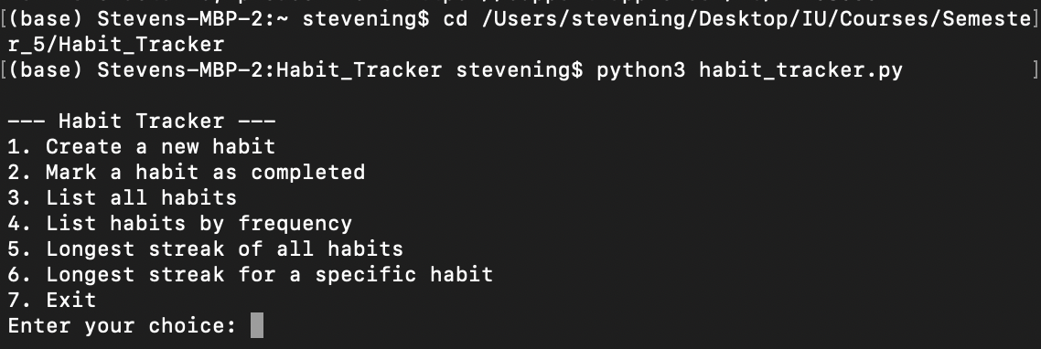
User Interface
Users must navigate to the location of the app files in a shell application.
Type python3 habit_tracker.py to start the application.
Users will see a list of actions to perform and must enter the number corresponding to an action to perform the action.

Slide 4
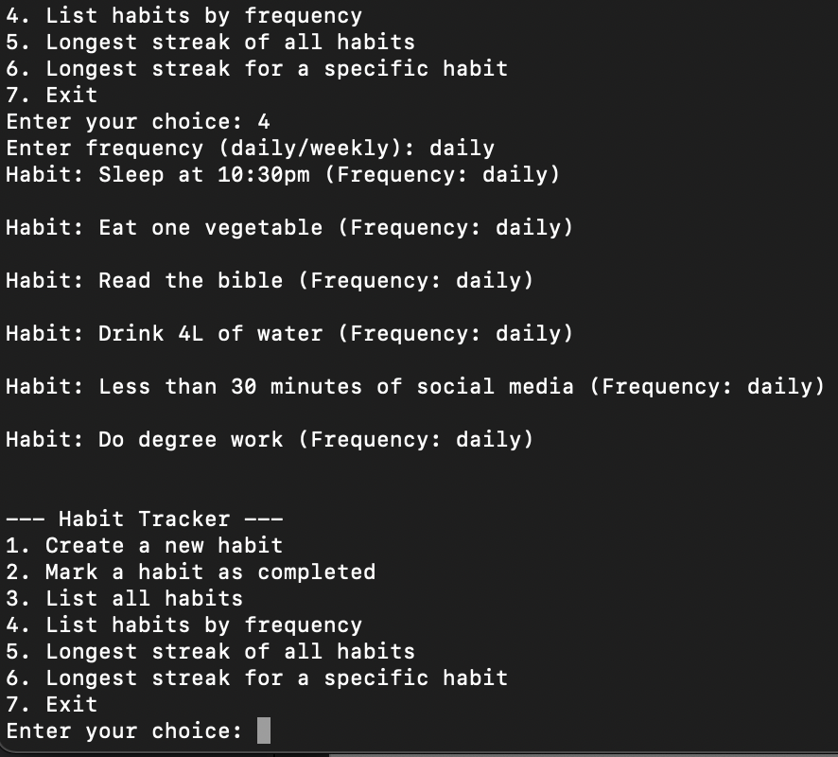
User Interface (continued)
Some choices will require the user to enter more information.
When the app has all the information it needs to perform an action, it will display an output.
The main menu is displayed again after each action is completed, except for ”7. Exit” which closes the app.

Slide 5
Habit class
Attribute | Type | Description
name | string | Name of habit
frequency | string | Frequency of habit: ‘daily’ or ‘weekly’
creation_date | datetime | Date when habit was created
completions | list | List of datetime objects representing completion dates
Purpose: creates a habit instance
Habit instance includes a habit name, frequency (daily or weekly), creation date, a list of completion dates, and a streak value for each habit

Slide 6
Habit class (continued)
Method | Parameters | Description | Interaction with Attributes
__init__() | name, frequency, creation_date | Initializes new habit instance | Assigns name and frequency typed by user to variables of the same name. Assigns datetime when the habit was created to variable creation_date
add_completion() | date_time | Adds habit completion date(s) to the completion list of a habit | date_time represents completion datetime(s) created by other methods
complete() |  | Automatically adds datetime to completions list when user logs a completion. Displays a message to user with the completion datetime | Modifies the completions attribute by adding a completion date to the empty list
streak() |  | Calculates the longest streak of consecutive habit completions | Uses the completions attribute filled with all the completion datetimes for a habit to calculate longest streak

Slide 7
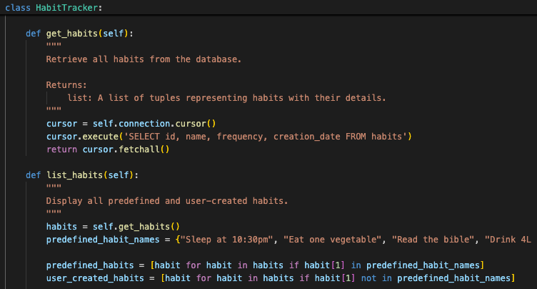
Habittracker class
Purpose: manages habits and interacts with the database
The control center of the app, is responsible for performing most of the actions of the app
Contains methods that: create database tables, create and add predefined data to databases, list habits, list habits by frequency, calculate longest streak of all habits and selected habits, and add new habits and completions to the database

Slide 8
Habittracker class (continued)
Method | Parameters | Description
__init__ | db_name=“habit_tracker.db” | Sets up the connection to the database. Calls the create_tables() and add_predefined_habits() methods to create the ‘habits’ and ‘completions’ tables in the database and add predefined data to it.
create_tables() |  | Creates the ‘habits’ and ‘completions’ tables in the database
add_predefined_habits() |  | Adds the predefined habits and 4 weeks of completion data to the database
get_habits() |  | Retrieves all habits from the database
list_habits() |  | Calls get_habits() method to retrieve all habits and separates the habits as predefined and user-created habits. Displays a list of habits to the user.
list_habits_by_frequency() | frequency | Lists all daily or weekly habits. Calls get_habits() method to retrieve all habits and filters for habits that equal ‘frequency’ from the Habit class using functional programming.
longest_streak_of_all_habits() |  | Calculates and displays the longest streak across all habits. Calls get_habits() and then finds the longest streak and the habit associated with it with functional programming.

Slide 9
Habittracker class (continued)
Method | Parameters | Description
longest_streak_for_habit() | name | Displays the longest streak for a specific habit. Calls find_habit() to populate ‘completions’ from the Habit class with all the completion datetimes for a habit. Uses ‘name’ and ‘longest_streak’ from the Habit class
find_habit() | name | Finds a habit by name and populates ‘completions’ from the Habit class with all the completion datetimes for a habit. Uses ‘name’ from the Habit class to select the correct habit from the database.
create_habit() | name, frequency | Adds habit information for a new habit to the database. Uses ‘name’ and ‘frequency’ values from the Habit class for the name and frequency information.
complete_habit() | name | Adds the current datetime as a completion date to the database and calls complete() from the Habit class to add the datetime to the list of completions
__del__() |  | Closes the database connection

Slide 10
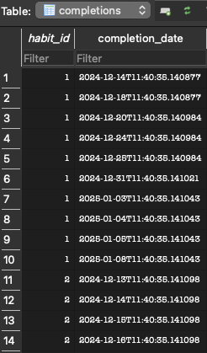
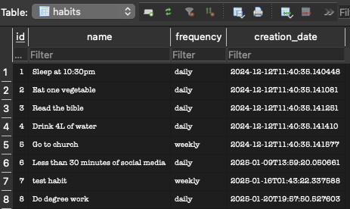
SQLITE3 DAtabase
A relational database
Contains 2 tables: habits and completions
habits contains all the habit information such as id, name, frequency, and creation date
completions contains a habit_id field and completion_date field
Habits are linked to completions using the ID fields, i.e., a habit in the habits table will have the same ID value as its completions in the completions table

Slide 11
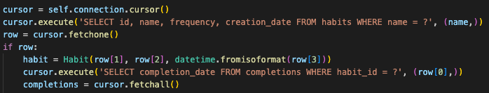
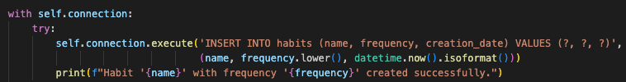
Interacting with database
The HabitTracker class uses SQL to retrieve and send information to and from the database

